Slide 1


Finding the best neighborhood to open a cafe in Brooklyn, New York.
IBM DATA SCIENCE CAPSTONE PROJECT
By: Ashish Kumar

Slide 2
Problem Statement
We will be exploring the option to open a coffee shop in Brooklyn neighbourhoods through this project. I will assume that the businessman/ owner wants to open a coffee shop in Brooklyn with the need to attract more customers which will be our focus of the project. Here I will be working on this project in hope to find the most suitable neighbourhood for owner to meet the mentioned conditions.

Slide 3
Data
We need borough and neighbourhood dataset of the Brooklyn, New York.
Luckily, A data repository site which is publicly available for users to download in structured data formats for New York state. It also comes with the geo location of the neighbourhoods which will be helpful for our project. We will be using this data and filter the dataset accordingly.
https://geo.nyu.edu/catalog/nyu_2451_34572
I will be also be using Foursquare API to get the coffee shops details on this neighbourhoods.

Slide 4
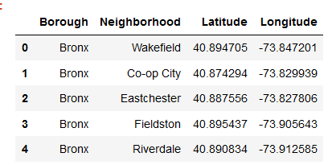
Data Cleaning
As we have downloaded the data in JSON format, we will have to convert this in pandas data frame to work with it.
After uploading it to data frame, I have cleaned the data by removing the unwanted data (columns, rows etc)

Slide 5
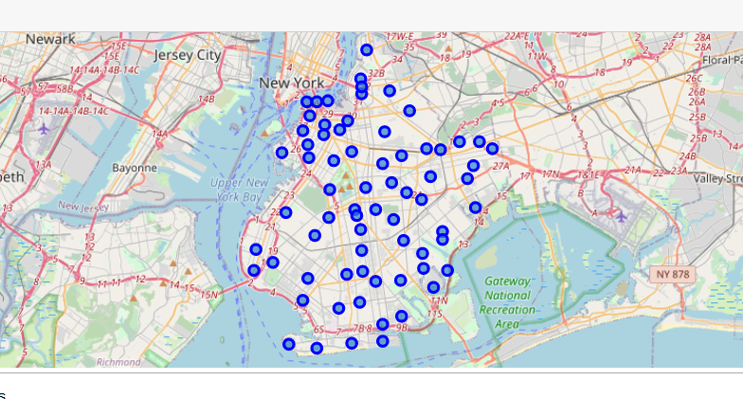
Data Understanding
Also, the data we have downloaded is for New York state. We will have to filter the data for Brooklyn. After filtering the data we can see these neighbourhood in the map to understand the neighbourhood

Slide 6
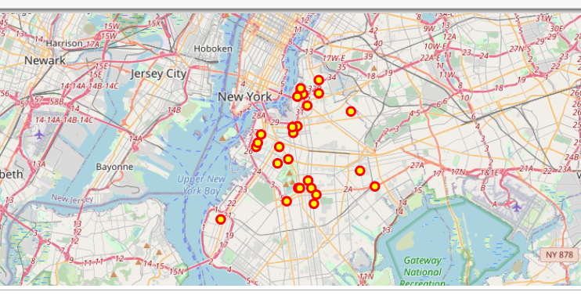
Data
After this we will use foursquare API to get all the coffee shops details in the neighbourhood of Brooklyn. After converting and cleaning the json response data from JSON, we uploaded the data into pandas dataframe for more readability and further process.
We can see the Brooklyn neighbourhood’s coffee shops in the map for more understanding and clarity of data.

Slide 7
Data Modelling
The time has finally come to run the algorithm and solve our problem of finding the best neighbourhood for owner. As we are going to use clustering model which is unsupervised type of machine leaning model. Here we do not have to split the data into train and test dataset as we do in supervised learning models. I will use the K Means clustering method of unsupervised model.

Slide 8
Data Modelling: K Means Model
K- Means Clustering:
In K Means Modelling, we set the number of clusters prior to fit the model. In this project, I have chosen the number of clusters as 3 and build the model. Once the model is built, I have feed the above generated data to the model.

Slide 9
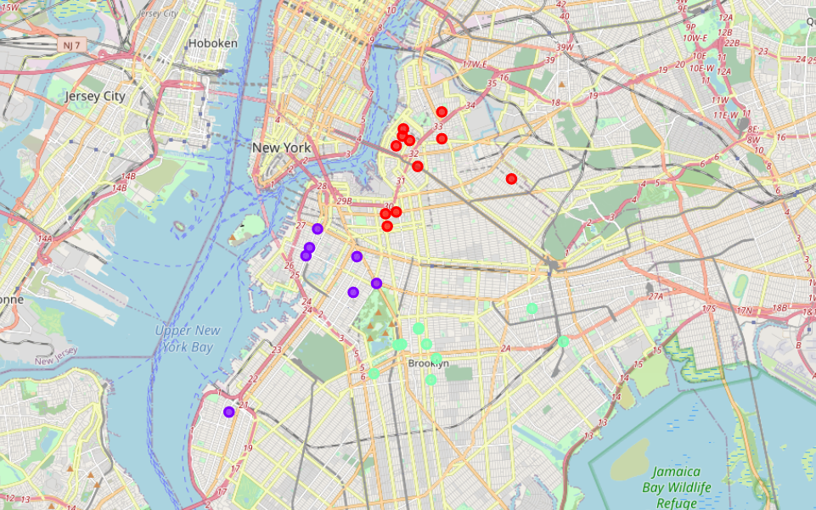
Model Evaluation
Let us visualize the generated clusters by our model in the map. We can see 3 different coloured dots in the map, each colour represents a cluster.

Slide 10
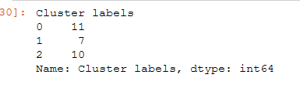
Result
Let us see the model evaluation results, we can see the number of coffee shops present in different clusters. As per this, we can clearly say that owner should open new coffee shop in cluster 1.

Slide 11
Conclusion
After visualizing the clusters on the map and seeing the number of coffee shops present in all the cluster neighbourhoods. It seems the best option would be to open coffee shop on cluster 1 area as this area has less numbers of coffee shops.

Slide 12
Thank You
Please feel free to share your feedback to improve this project.

